Slide 1
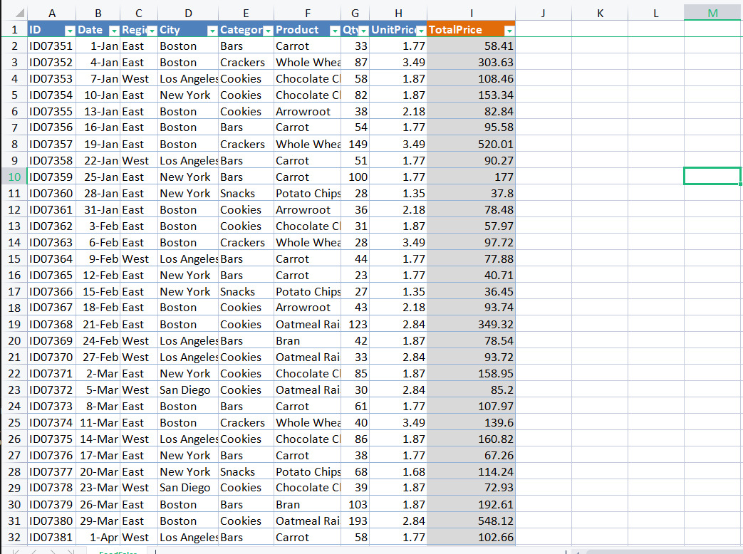

Portfolio 03
How could Numpy help you to process these ???

Slide 2
First what is Numpy ???

Slide 3
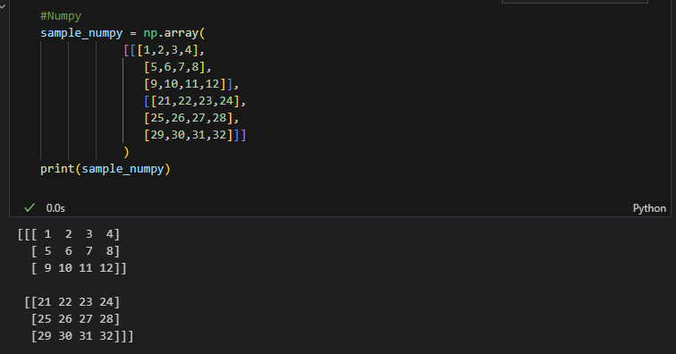
It is a Python library that provides a multidimensional array object, various derived objects (such as masked arrays and matrices), and an assortment of routines for fast operations on arrays, including mathematical, logical, shape manipulation, sorting, selecting, I/O, discrete Fourier transforms, basic linear algebra, basic statistical operations, random simulation and much more.
Reference: Numpy.org
What's is special with numpy? If we had already have a List!!!

Slide 4

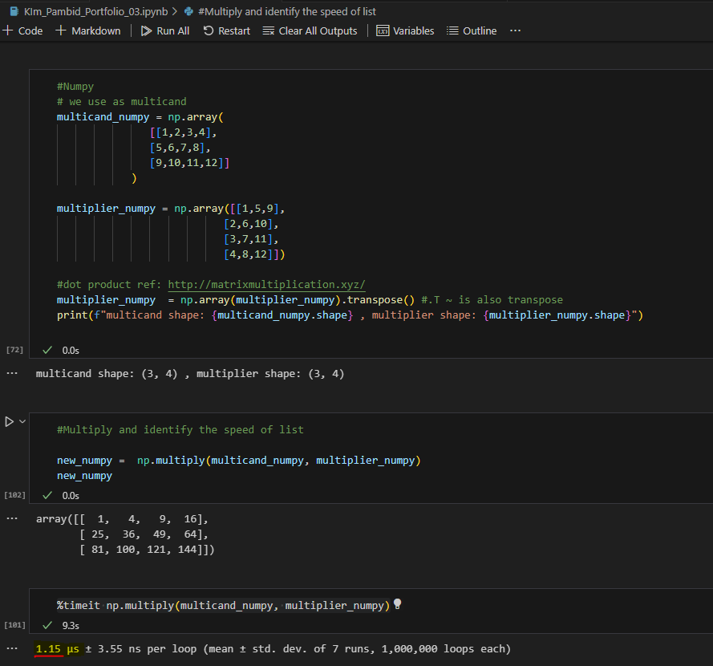
Numpy better because:
a. It use binary (1 & 0) in tranformation and computing.
b. Well used in large scale of data.
c. Behind the scenes optimization written in C language.
d. Vectorization via broadcasting (avoiding loops)
How fast is the process time of Numpy.
Lets compute the speed by multiplying it with another matrix
Note: Let’s use dot product source info(http://matrixmultiplication.xyz/)
Imagine applying this to excel!!!!!

Slide 5
Applying excel to Pandas and Numpy computation
and change the amount currency to euro

Slide 6

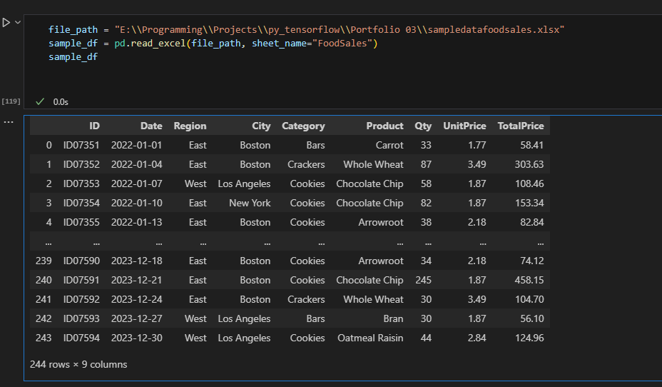
First what is Pandas??
Not this panda
It is a Python library used for working with data sets.
It has functions for analyzing, cleaning, exploring, and manipulating data.
Pandas is actually built on top of Numpy.
Lets upload the data from excel spreadsheet to our system :p

Slide 7
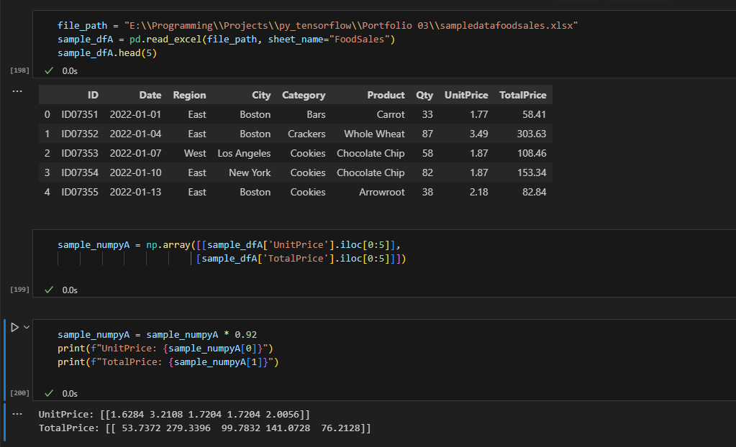
Apply it for Numpy

Slide 8
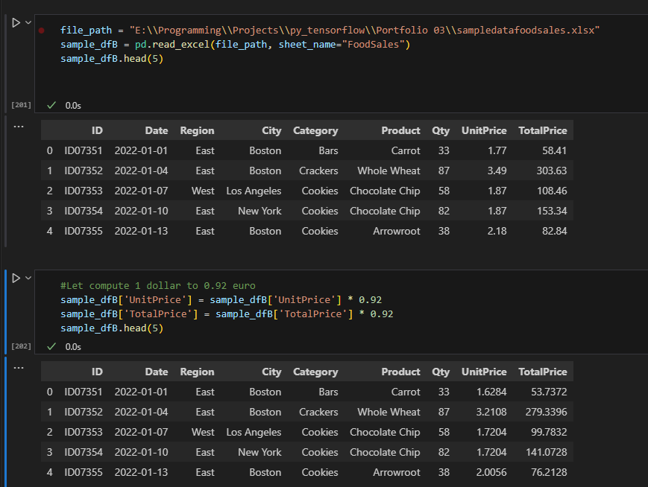
Apply it for Pandas

Slide 9
Saving Pandas dataframe into a new workbook

Slide 10
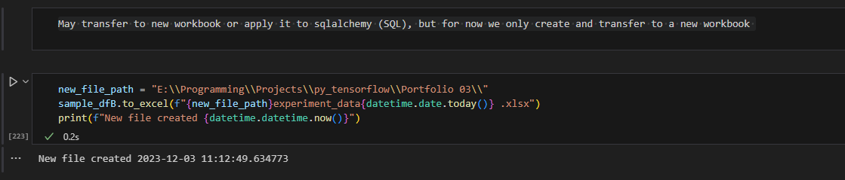
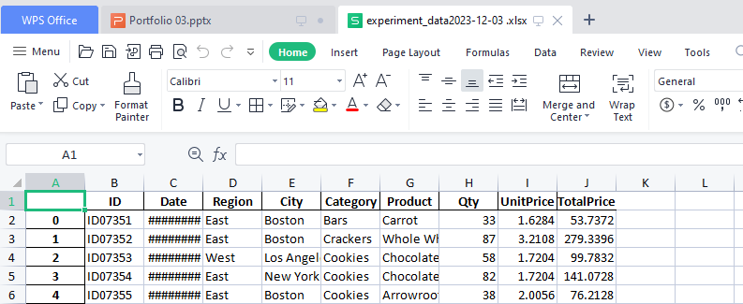

Slide 11
Bonus: How to Graph or Chart

Slide 12
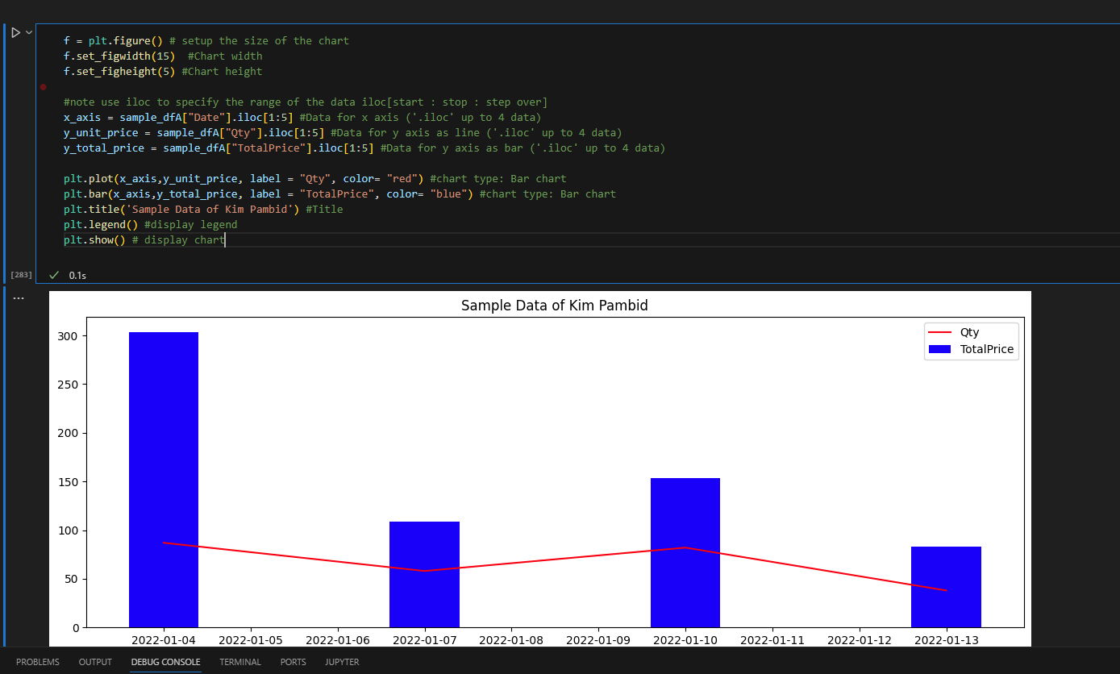
Use matplotlib.pyplot then follow the box

Slide 13
How to displaying image and get its numpy matrix for TensorFlow

Slide 14
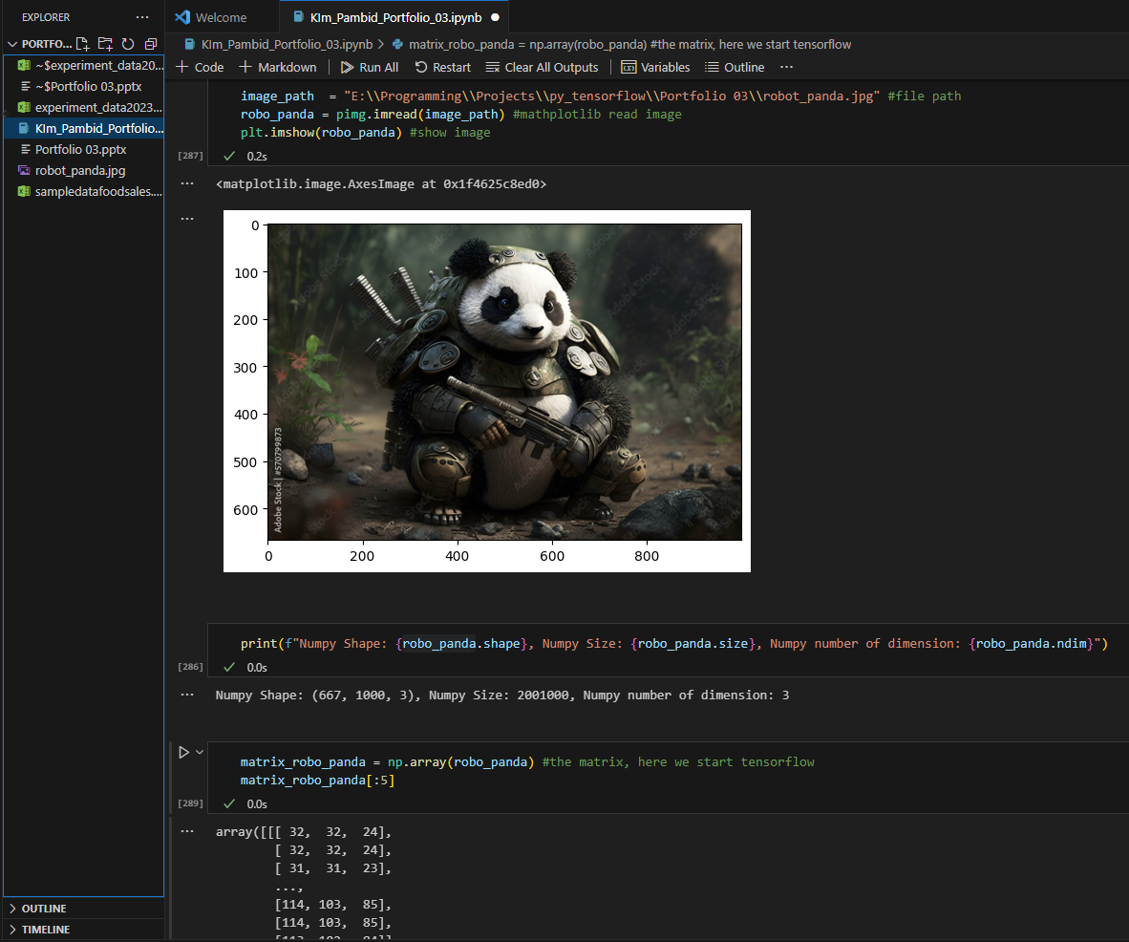
The ‘blue box ’ setup and display the image.
The ‘green box ’ set the image to numpy array / matrix
Resources: Excel data https://www.contextures.com/
Panda Image: https://stock.adobe.com/bg/images/warrior-panda-created-using-ai-generative-technology/570799873

Slide 15
That All Folks
Thanks for viewing!!!

